Slide 1
H: Use of random effects in a stock assessment
Day 3: 10h00-11h00

Slide 2
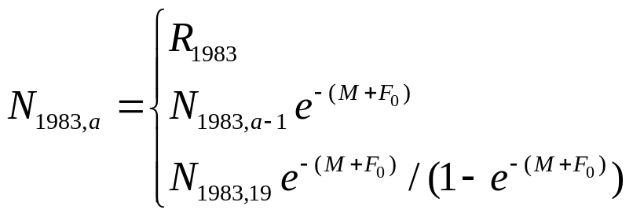
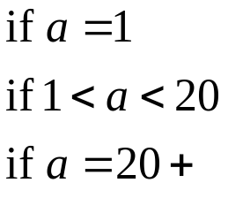
Introduction-I
The qR method involves fitting an age-structured population dynamics model to time-series of catch-in-number and catch-in-weight data. The model is “effort conditioned”. The initial conditions (“1983” for rock lobster in South Australia) are:

Slide 3
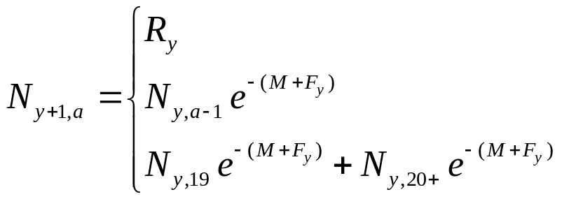

Introduction-I
The annual dynamics are governed by
Fishing mortality is related to effort according to:

Slide 4
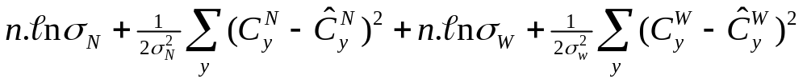
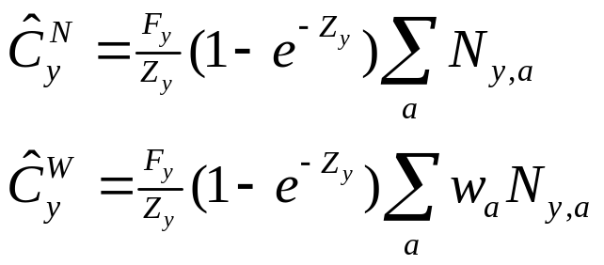
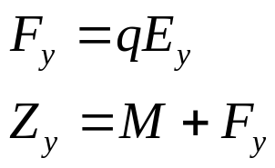
Parameter estimation
The parameters of the population dynamics model are: M (assumed known), {R_{y}: y=1983, 1984,…}, F₀, and q. The negative log-likelihood function is given by:
where:
and

Slide 5
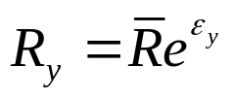

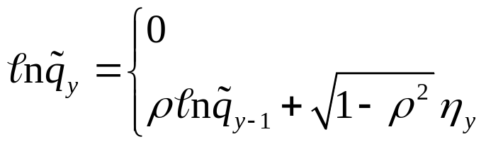
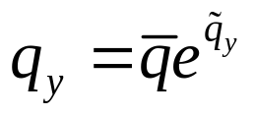

Scenarios-I
The basic scenario treats all of the parameters as fixed effects, but we will consider some alternate models:
The annual recruitments (1984 onwards) are treated as random effects, i.e.:
Catchability is modelled as a AR(1) process, i.e.

Slide 6
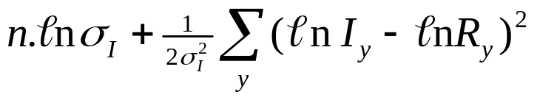
Scenarios-II
There is an index of recruitment, i.e.:
where the extent of observation variation is an
estimated parameter.

Slide 7
Evaluation-I
The data available are 35 years of effort and catch-in-number and in-mass.
The performance metrics are the rmses for biomass, recruitment and q.
Two scenarios are considered:
q is constant and equal to 0.1
q changes as a AR(1) process and with ρ=0.9 and a standard deviation of 0.2.

Slide 8
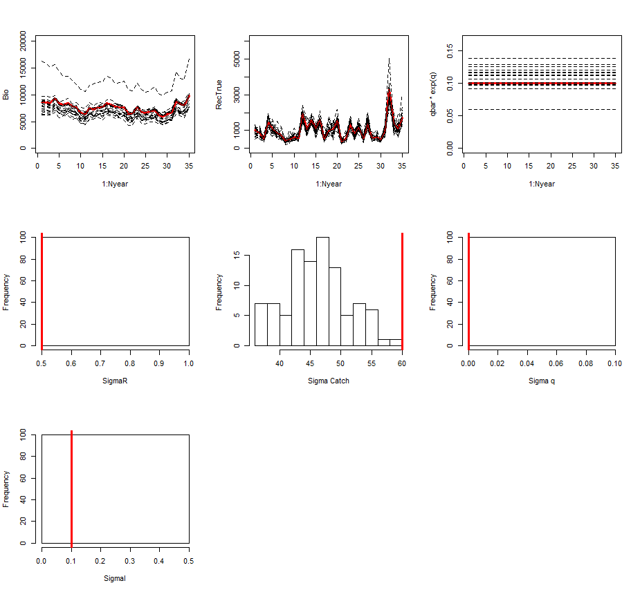
Fixed effects analysis

Slide 9
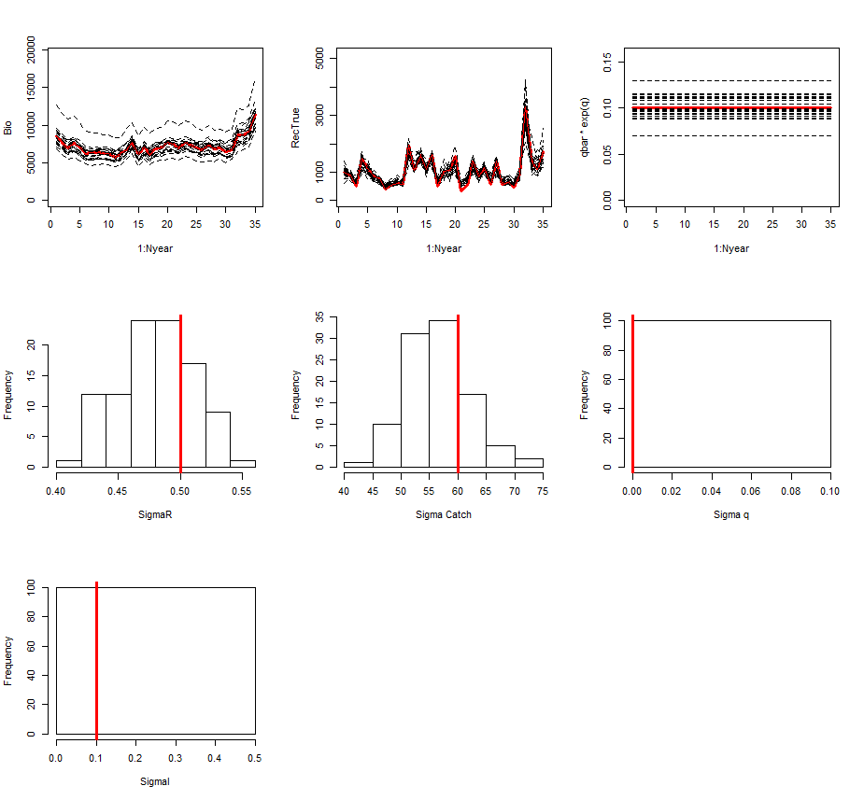
Recruitment is a random effect

Slide 10
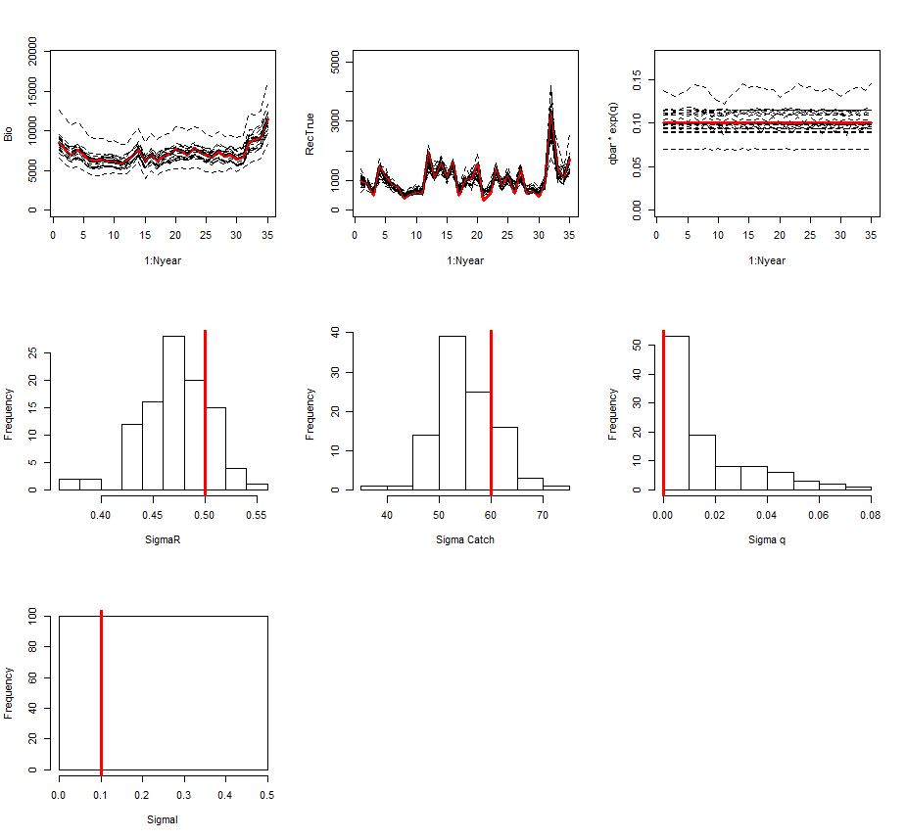
Recruitment and q are random effects

Slide 11
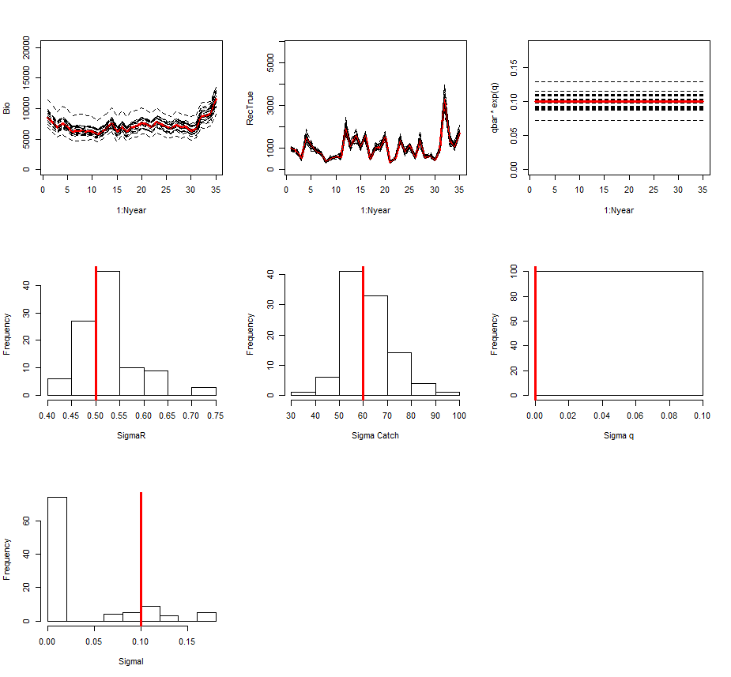
Recruitment is a random effect, and there is a good recruitment index

Slide 12
Summary-I
Constant q
 | Biomass | Recruitment | q
Fixed effects | 20.07 | 24.84 | 19.37
Random recruitment | 12.74 | 25.49 | 12.87
Random recruitment and q | 12.94 | 25.81 | 13.31
Random recruitment and an index | 16.51 | 11.64 | 14.88

Slide 13
Summary-II
Time-varying q
 | Biomass | Recruitment | q
Fixed effects | 17.73 | 43.48 | 15.11
Random recruitment | 15.53 | 31.71 | 15.02
Random recruitment and q | Crashed!
Random recruitment and an index | Outlier!

Slide 14
Conclusions
Allowing for random effects improves estimates of recruitment and also of σ_{R}, and the extent of observation error.
There is not enough information to estimate trends in q from catches-in-number and in –in-weight alone.
In principle, a random effects model can estimate to weight to assign to an index of recruitment but some simulations led to degenerate solutions.

